Slide 1


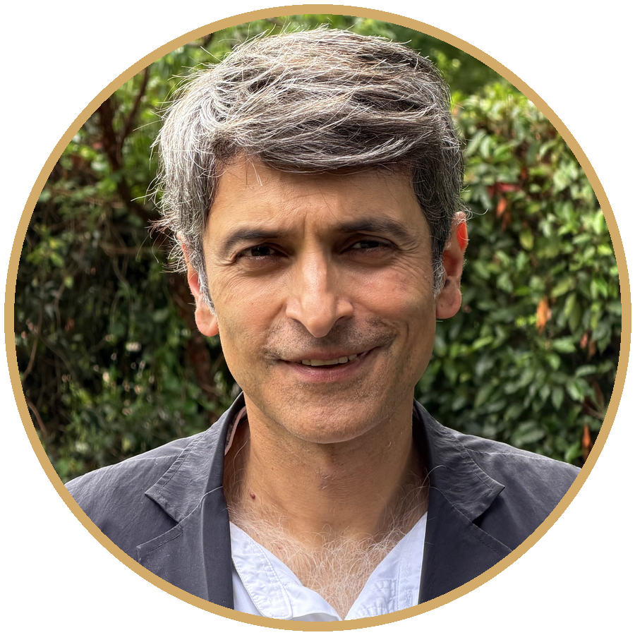
Sleep, exercise and nutrition
The daily foundations that make everything else work
Dr Ravi Assomull MA MD FRCP
Personalised. Proactive. Precise.
Consultant Cardiologist · 68 Harley Street, London
29th September 2026
Notes:
Good evening, and thank you for coming. I'm Ravi Assomull, a consultant cardiologist, and I run an integrative cardiology practice here on Harley Street.
Most of my working life is spent looking inside hearts with scans and tests. But the thing I've become most passionate about is what happens before anyone needs those scans: the numbers you can check and the habits you can change.
Tonight has four parts. First, cholesterol, including two newer blood tests, apolipoprotein B and lipoprotein(a), that I think everyone should know about. Second, blood pressure: what it is, how to measure it properly and how to bring it down. Third, weight, including the new GLP-1 weight-loss medicines that everyone is asking about. And finally the foundations: sleep, exercise and nutrition.
Everything I'll show you is drawn from international guidelines and published trials, and I'll be honest where the evidence is weaker or still emerging. None of this replaces a personal consultation, because the right target for you depends on your own risk.

Slide 2
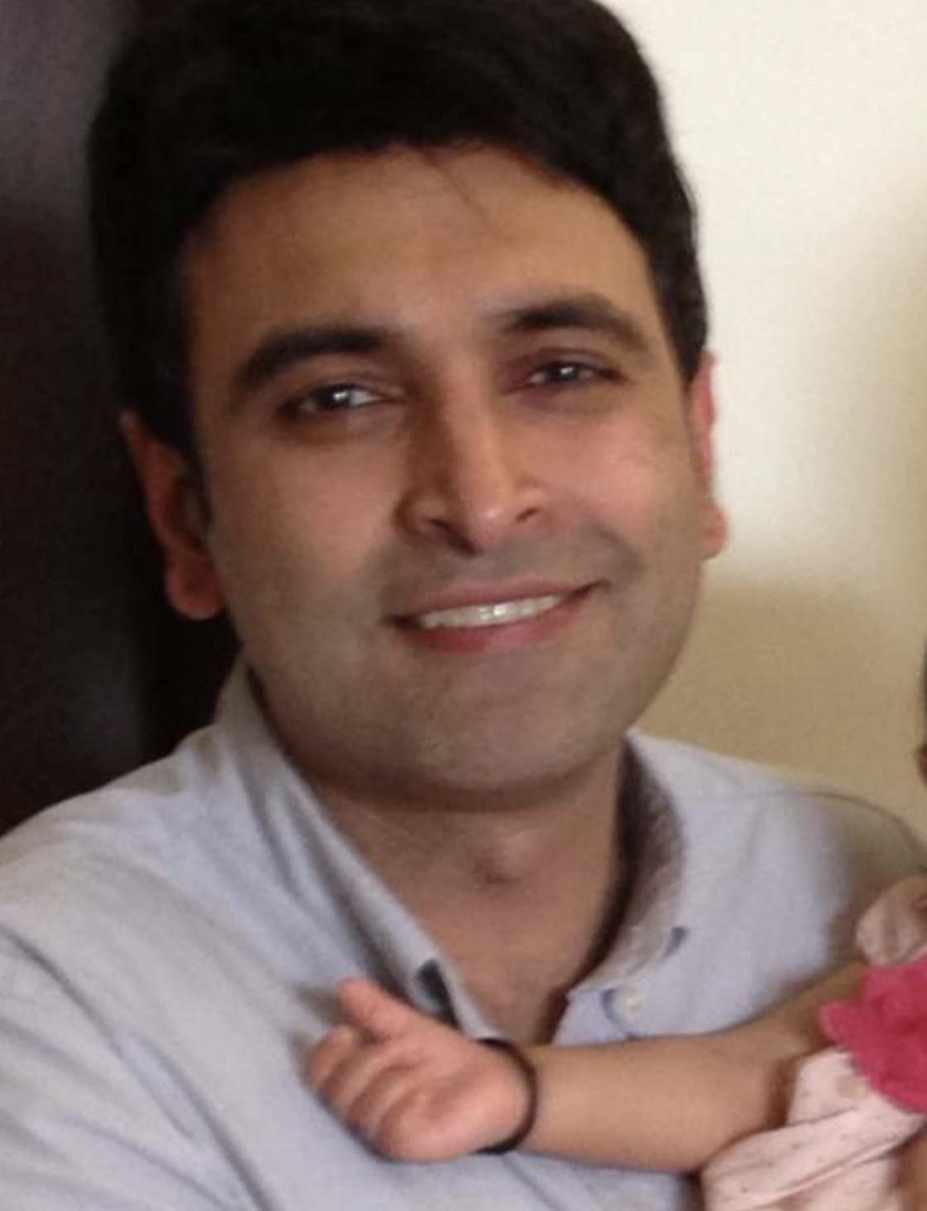
Sleep, exercise and nutrition
The daily foundations that make everything else work
Dr Ravi Assomull MA MD FRCP
Personalised. Proactive. Precise.
Consultant Cardiologist · 68 Harley Street, London
Notes:
Good evening, and thank you for coming. I'm Ravi Assomull, a consultant cardiologist, and I run an integrative cardiology practice here on Harley Street.
Most of my working life is spent looking inside hearts with scans and tests. But the thing I've become most passionate about is what happens before anyone needs those scans: the numbers you can check and the habits you can change.
Tonight has four parts. First, cholesterol, including two newer blood tests, apolipoprotein B and lipoprotein(a), that I think everyone should know about. Second, blood pressure: what it is, how to measure it properly and how to bring it down. Third, weight, including the new GLP-1 weight-loss medicines that everyone is asking about. And finally the foundations: sleep, exercise and nutrition.
Everything I'll show you is drawn from international guidelines and published trials, and I'll be honest where the evidence is weaker or still emerging. None of this replaces a personal consultation, because the right target for you depends on your own risk.

Slide 3

Sleep, exercise and nutrition
Talk available for download on:
www.cardiologist.london/download
Notes:
Our final section is about the foundations: sleep, exercise and nutrition. Everything we've discussed so far, cholesterol, blood pressure and weight, is shaped by these three. And unlike your genes, they're under your control every single day.

Slide 4
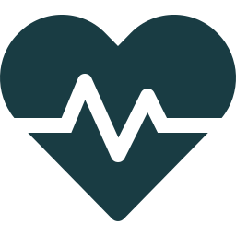

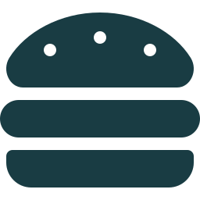

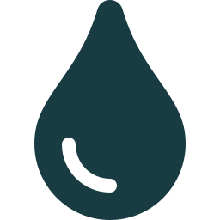



SLEEP
Why we sleep: Matthew Walker’s key ideas
Two forces control sleep
What short sleep does to the body
Sleep pressure: adenosine builds up in the brain the longer you are awake. Caffeine works by blocking it.
Raises sympathetic (“fight or flight”) activity and evening cortisol
Two short nights: leptin (fullness) down 18%, ghrelin (hunger) up 28%
Body clock: a roughly 24-hour circadian rhythm, set largely by light, that times sleep and alertness.
Reduces glucose tolerance within a week of sleep debt
Each extra hour of sleep linked to lower odds of new coronary calcium (observational)
Deep (non-REM) sleep helps lay down memories; REM sleep is linked to emotional processing.
Alcohol helps you drop off but fragments the second half of the night and delays REM
Walker M. Why We Sleep (2017); Borbély AA, Hum Neurobiol 1982 (two-process model); Spiegel K et al., Lancet 1999 and Ann Intern Med 2004; King CR et al., JAMA 2008; Ebrahim IO et al., Alcohol Clin Exp Res 2013.
Notes:
For the sleep section I've drawn on Matthew Walker's book, Why We Sleep, which did a great deal to put sleep on the public health agenda. I'll also tell you where later evidence has corrected some of its claims.
Walker explains that two forces control sleep. The first is sleep pressure: a chemical called adenosine builds up in the brain the longer you're awake, making you progressively sleepier. Caffeine works by blocking adenosine receptors, which is why it masks tiredness. The second is your body clock, the circadian rhythm, which runs on a roughly 24-hour cycle set mainly by light.
He describes deep non-REM sleep as important for laying down memories, and REM sleep, when we dream, as linked to emotional processing. That's a mainstream view, though some of REM sleep's functions are still being worked out.
What happens when we don't sleep enough? In small laboratory studies, restricting sleep raised "fight or flight" nervous activity and evening cortisol, and reduced glucose tolerance within a week. Just two nights of short sleep lowered the fullness hormone leptin by 18% and raised the hunger hormone ghrelin by 28%, and people felt hungrier. A population study found that each extra hour of sleep was linked with lower odds of developing coronary calcium over five years, although that's an association, not proof.
And Walker is right about alcohol: it helps you fall asleep but fragments the second half of the night and delays REM sleep.

Slide 5

SLEEP
Sleep and the heart: what the wider evidence shows
7–9 h
Sleep apnoea
Recommended for adults; sleep is now one of the AHA’s “Life’s Essential 8”
Linked to high blood pressure and atrial fibrillation
Loud snoring, pauses in breathing or daytime sleepiness: ask for a test
CPAP improves sleepiness, mood and quality of life; in the SAVE trial it did not reduce heart events
Regularity counts
In 60,977 UK Biobank participants, consistent sleep timing predicted lower mortality more strongly than sleep duration.
Watson NF et al. Sleep 2015 (AASM/SRS consensus); Lloyd-Jones DM et al., Circulation 2022 (Life’s Essential 8); Cappuccio FP et al., Eur Heart J 2011; Windred DP et al., Sleep 2024; Peppard PE et al., NEJM 2000; SAVE (McEvoy RD et al., NEJM 2016).
Notes:
Let me anchor the sleep message in the wider evidence.
The American Academy of Sleep Medicine and Sleep Research Society recommend at least seven hours for adults, and in 2022 the American Heart Association added sleep to its "Life's Essential 8" measures of heart health, with seven to nine hours scoring best.
The chart shows a large meta-analysis of nearly half a million people. Compared with seven to eight hours, short sleep was associated with a 48% higher risk of coronary heart disease. But long sleep was also associated with higher risk, especially of stroke. So the relationship is U-shaped. Long sleep may partly be a marker of underlying illness or poor-quality sleep rather than a cause.
A 2024 UK Biobank study using wrist-worn activity trackers in about 61,000 people found that sleep regularity, going to bed and getting up at consistent times, predicted mortality more strongly than sleep duration. That's a very practical message.
And please don't ignore sleep apnoea. It's strongly linked with high blood pressure and atrial fibrillation. If you snore loudly, someone has noticed you stop breathing, or you're sleepy in the day, ask for a sleep study. I'll be honest that in the SAVE trial, CPAP didn't reduce heart attacks and strokes in people with established heart disease, although average use was only about three hours a night. But it clearly improves sleepiness, mood and quality of life.

Slide 6





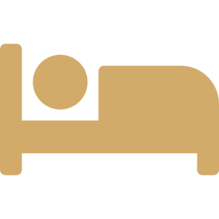


SLEEP
Your sleep prescription
Keep regular times
Give yourself 7+ hours
Caffeine cut-off
No nightcap
Same bedtime and wake time, including weekends.
Protect the time in bed you need.
None for at least 6 hours before bed; earlier if you’re sensitive.
Alcohol disrupts the second half of the night.
Dark, cool, screen-free
Don’t lie awake
Insomnia? Ask for CBT-I
Snoring? Get checked
And get bright daylight in the morning.
If you can’t sleep, get up, do something calm, then return.
The first-line treatment, in person or digital, before sleeping pills.
Especially with high blood pressure or AF.
Walker M. Why We Sleep (2017), “Twelve tips for healthy sleep”; Windred DP et al., Sleep 2024; Drake C et al., J Clin Sleep Med 2013; Riemann D et al., European Insomnia Guideline, J Sleep Res 2023; NICE MTG70 (digital CBT-I) and TA922.
Notes:
So here's your sleep prescription. Five of these come straight from Walker's own twelve tips, and they're well supported.
Keep regular sleep and wake times, including at weekends. That's probably the single most useful habit.
Give yourself at least seven hours of opportunity to sleep.
Have a caffeine cut-off. In one study, 400 milligrams of caffeine taken even six hours before bed disrupted sleep, and people didn't realise it. So for most people, no coffee after early afternoon.
Don't use alcohol as a sleeping aid.
Keep the bedroom dark, cool and free of screens, and get bright daylight in the morning to anchor your body clock.
If you can't sleep, don't lie there getting frustrated. Get up, do something calm in dim light, and go back when you feel sleepy.
If insomnia persists, three nights a week or more for months, ask about cognitive behavioural therapy for insomnia, CBT-I. European guidelines and NICE recommend it as the first-line treatment, and it's available in digital form. Sleeping pills are for short-term use.
And if you snore loudly or someone has noticed pauses in your breathing, particularly if you have high blood pressure or atrial fibrillation, please ask for a sleep apnoea test.

Slide 7
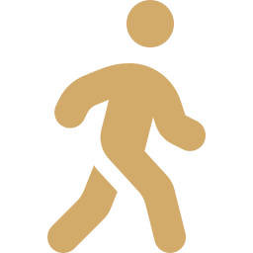
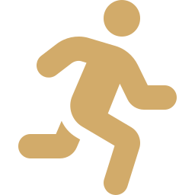
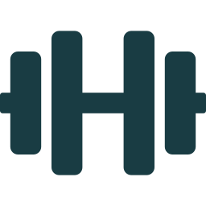
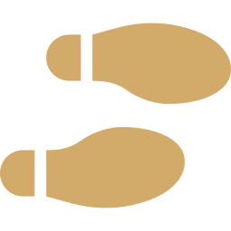
EXERCISE
How much exercise? What the guidelines say
150–300
75–150
2+
Less
minutes a week of moderate activity
minutes a week of vigorous activity
days a week of resistance training
sitting
brisk walking, cycling, swimming: you can talk but not sing
or an equivalent mix: running, hard cycling, sport
working all major muscle groups
break up long periods; any movement counts
Broadly aligned across ESC, US, WHO and UK CMO guidance. Older adults: add balance and strength work to reduce falls. If you’re starting from zero, build up gradually: some is better than none.
ESC 2021 Guidelines on CVD prevention (Visseren FLJ et al.); ESC 2020 Sports Cardiology Guidelines (Pelliccia A et al.); 2019 ACC/AHA Primary Prevention Guideline and 2018 US Physical Activity Guidelines; WHO 2020 Guidelines (Bull FC et al.); UK Chief Medical Officers’ guidelines 2019.
Notes:
On exercise, the international guidelines speak with one voice.
The European Society of Cardiology, the World Health Organization, the UK Chief Medical Officers and the US physical activity guidelines all recommend at least 150 minutes a week of moderate-intensity activity, ideally up to 300, or 75 to 150 minutes of vigorous activity, or a mix of the two. Moderate means you can talk but not sing: brisk walking, cycling, swimming.
Just as important, and often forgotten: resistance or muscle-strengthening exercise on at least two days a week, working all the major muscle groups. The ESC gives that a class one recommendation, its strongest.
Reduce sedentary time, and break up long periods of sitting.
For older adults, the UK and WHO guidance adds activities that improve balance and strength, which reduce falls.
And if you're starting from nothing, the ACC/AHA guideline says it plainly: some activity, even below the target, is beneficial. Build up gradually.

Slide 8
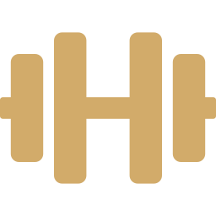
EXERCISE
The dose–response: the biggest win is from none to some
Steps
Benefit starts from around 2,500 steps a day and levels off at roughly 7,000–9,000. 10,000 is not a magic number.
Fitness
Each 1-MET increase in fitness is linked to about 13% lower mortality.
Strength work
30–60 minutes a week of muscle-strengthening is linked to 10–20% lower mortality and CVD.
Arem H et al. JAMA Intern Med 2015; Stens NA et al. JACC 2023; Kodama S et al. JAMA 2009; Momma H et al. BJSM 2022; Mandsager K et al. JAMA Netw Open 2018. All observational associations.
Notes:
How much benefit do you get from how much exercise?
The chart comes from a pooled analysis of over 660,000 adults. Compared with doing nothing, even less than the recommended minimum was associated with a 20% lower risk of death. Meeting the minimum, about 31% lower. Three to five times the minimum, 39% lower, where the benefit levelled off, with no sign of harm at higher amounts. So the biggest single gain is going from nothing to something.
On steps: a 2023 analysis of over 100,000 people found benefit starting from about 2,500 steps a day, with the optimum around 7,000 to just under 9,000. Ten thousand steps came from a marketing campaign, not science.
Fitness itself is a powerful predictor. Each one-MET increase, roughly the difference between a slow and a moderate jog on a treadmill test, is associated with about 13% lower mortality.
And strength training: a 2022 meta-analysis found that 30 to 60 minutes a week of muscle-strengthening activity was associated with 10 to 20% lower risk of death and cardiovascular disease. Interestingly, the curve was J-shaped, and the benefit of much larger volumes is unclear. These are all observational associations, but they're remarkably consistent.

Slide 9
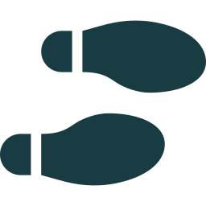

EXERCISE
Walk at least 8,000 steps a day, and keep moving in between
NEAT: non-exercise activity thermogenesis
The energy you burn through everything that isn’t sleeping, eating or deliberate exercise: walking, standing, climbing stairs, housework, gardening, even fidgeting.
8,000+
It protects against weight gain
Sitting time adds up
steps a day: my everyday target
When 16 volunteers were overfed by 1,000 kcal a day for 8 weeks, about two-thirds of the rise in their energy expenditure came from NEAT, and it explained a ten-fold difference in how much fat they gained.
In a detailed monitoring study, people with mild obesity sat about 2 hours a day longer than lean people. Matching the lean group’s movement could burn roughly 350 kcal more a day.
Each extra 1,000 steps a day: ~15% lower all-cause mortality
Risk keeps falling to about 7,000–9,000 steps
Even 8,000+ steps on just 1–2 days a week is linked to lower mortality
Easy ways to add NEAT
Walk or cycle part of your commute
Take stairs, not lifts
Walking meetings and phone calls
Stand or move every 30 minutes
10-minute walk after meals
Banach M et al. Eur J Prev Cardiol 2023 (17 cohorts, 226,889 people); Stens NA et al. JACC 2023; Inoue K et al. JAMA Netw Open 2023; Levine JA et al. Science 1999; Levine JA et al. Science 2005. Step studies are observational associations.
Notes:
I want to single out walking, because it's the easiest, cheapest and most sustainable exercise there is. My everyday target for patients is at least 8,000 steps a day.
The evidence is striking. A 2023 meta-analysis in the European Journal of Preventive Cardiology pooled 17 studies with nearly 227,000 people. Every extra 1,000 steps a day was associated with about a 15% lower risk of death from any cause, and every extra 500 steps with about 7% lower cardiovascular mortality. Another analysis found the benefit keeps accruing up to roughly 7,000 to 9,000 steps. And a US study of about 3,000 adults found that even people who hit 8,000 steps on just one or two days a week had lower mortality over ten years than those who never did. These are observational studies, but they're remarkably consistent.
This links to a concept I find really useful: NEAT, which stands for non-exercise activity thermogenesis. It's the energy we burn through everything that isn't sleeping, eating or deliberate exercise: walking to the shops, standing, climbing stairs, housework, gardening, even fidgeting.
NEAT matters more than most people realise. In a classic study from the Mayo Clinic, 16 volunteers were overfed by 1,000 calories a day for eight weeks. About two-thirds of the increase in their energy expenditure came from NEAT, and differences in NEAT explained a ten-fold difference in how much fat people gained. In a later study, the same team monitored posture every half-second for ten days: people with mild obesity sat for about two hours a day longer than lean people, and matching the lean group's movement could burn about 350 extra calories a day.
So, alongside your planned exercise, build movement into your day: walk or cycle part of the commute, take the stairs, have walking meetings, stand up every half hour, and take a short walk after meals.

Slide 10
EXERCISE
A resistance-training template: the weekly plan
3 resistance sessions + 3 cardio sessions + 1 rest day, every 7 days. Keep the order; start on any day.
Day 1
Day 2
Day 3
Day 4
Day 5
Day 6
Day 7
Cardio
Resistance
Rest
Resistance
Cardio
Cardio
Resistance
Zone 2
steady
45–75 min
Lower body
quads · hamstrings
calves
Recover
Torso
chest · back
abs & core
Zone 3/4
threshold
30 min
Zone 5
HIIT
6–25 min
Shoulders & arms
biceps · triceps
abs & core
Why once a week per muscle works: each group also gets indirect work on other days (pressing and pulling load the arms; sprints load the legs). Beginners: start with a few weeks of lighter, technique-focused training.
Adapted from Exercise Protocol 2 in Protocols (Andrew Huberman), as summarised in our Cardiologist London resistance-training guide. Guideline minimum is 2 resistance sessions a week; this plan uses 3.
Notes:
I want to give you something practical, so here's a template we've developed from Exercise Protocol 2 in the book Protocols, written up in our own resistance-training guide.
The guidelines ask for at least two resistance sessions a week. This plan goes a bit further, with three resistance sessions and three cardio sessions and one rest day in every seven. The order matters more than the start day.
Day one is steady Zone 2 cardio for 45 to 75 minutes, at an easy conversational pace. Day two is lower body: quads, hamstrings and calves. Day three is rest. Day four is torso: chest, back and core. Day five is a 30-minute threshold session, comfortably hard. Day six is a short high-intensity interval session of 6 to 25 minutes. And day seven is shoulders and arms.
Each muscle group is trained directly once a week, but it also gets indirect work on other days. Pressing and pulling on torso day works the shoulders and arms, and sprint intervals load the legs.
A word on "zones": they're a sports-science concept rather than cardiology guideline terms. Zone 2 simply means moderate intensity, where you can still hold a conversation.
If you're new to this, start with a few weeks of lighter, technique-focused training before pushing hard. And if you have a heart condition, please read my safety slide before you start.

Slide 11
EXERCISE
Inside each session: the key numbers
~60 min
4–9
5–30
Session length
Hard sets per muscle
Reps per set
5-min warm-up, then 1–3 lighter warm-up sets per exercise (about 40%, 65%, 75% of the first work-set weight).
Over 2–3 exercises; at least one compound (e.g. squat, row, press) and one isolation (e.g. curl, leg extension).
Compound lifts: usually 5–12. Isolation: 8–15. Effort matters more than the exact number.
1½–5 min
+5–10%
12–16 wk
Rest between sets
Progression
Deload
3–5 min for compound lifts; 1½–3 min for isolation; 1–2 min between warm-up sets.
Add weight or reps week by week in good form. Stalled for 2 weeks? Do fewer sets or take a week off.
Take a full week off resistance training every 12–16 weeks.
Adapted from Exercise Protocol 2 in Protocols (Andrew Huberman), as summarised in our Cardiologist London resistance-training guide. Figures are starting guidelines, not fixed rules.
Notes:
Inside each session, here are the key numbers.
Sessions last about an hour, give or take 20 minutes. Beyond about 80 minutes of hard training, fatigue builds faster than useful stimulus. Start with a five-minute whole-body warm-up, then do one to three progressively heavier warm-up sets before each exercise, at roughly 40, 65 and 75% of your first working weight, keeping well away from failure.
Aim for four to nine hard sets per muscle group, spread over two or three exercises. Include at least one compound, multi-joint movement like a squat, row or press, and one isolation exercise like a curl or leg extension.
A wide range of reps, from about 5 to 30, can build muscle, provided the set is hard. For compound lifts, choose a weight that gets hard at 5 to 12 reps; for isolation exercises, 8 to 15.
Rest three to five minutes between heavy compound sets, one and a half to three minutes for isolation, and one to two between warm-up sets.
Progressive overload drives everything: add a little weight or a rep or two each week, in good form. If you stall for two weeks, cut back a set or take a week off.
And every 12 to 16 weeks, take a full week off to let joints and tendons catch up. Most people come back stronger.

Slide 12

EXERCISE
Train safely: a cardiology perspective
Before you start
During every session
If you have heart disease, high blood pressure, or symptoms on exertion, get a medical review before high-intensity training or training to failure.
If you’re sedentary and over 35 with high risk, start at low to moderate intensity; ESC guidance suggests assessment (ECG, often an exercise test) before vigorous exercise.
Beginners, and anyone with a heart condition: stop 1–2 reps short of failure rather than taking sets to failure. This is expert advice; no guideline endorses training to failure for heart patients.
Breathe steadily; don’t hold your breath under heavy load (it sharply raises BP)
Use safety pins, a spotter or machines when lifting heavy alone
Muscle burn is fine; sharp joint pain means stop that exercise
Stop and seek advice if you get:
chest pain or pressure, breathlessness out of proportion, palpitations, dizziness or fainting, or unusual fatigue.
ESC 2020 Sports Cardiology Guidelines (pre-participation assessment; avoid Valsalva; interval training only in stable cardiac patients); AHA scientific statement on resistance exercise (Williams MA et al., Circulation 2007); Cardiologist London resistance-training guide.
Notes:
As a cardiologist, I have to add some safety guidance, particularly for anyone with a heart condition.
Resistance training is very safe for most people. But if you have known heart disease, high blood pressure, or symptoms such as chest pain, breathlessness, palpitations or dizziness on exertion, please get a medical review before starting high-intensity work or taking sets to failure.
The European sports cardiology guidelines say that people who are sedentary and at higher risk can start low-intensity exercise straight away, but should be assessed, usually with an ECG and often an exercise test, before vigorous training.
The template I showed takes sets to momentary failure. That's fine for healthy, experienced exercisers. For beginners, and for anyone with a heart condition, I advise stopping one or two reps short. I want to be clear this is my clinical advice; there's no guideline that endorses training to failure in heart patients. The ESC also advises that interval training is used only in stable cardiac patients.
During each session, breathe steadily. Holding your breath under heavy load, the Valsalva manoeuvre, causes sharp rises in blood pressure. Use safety pins, a spotter or machines when lifting heavy on your own. And learn the difference between muscle burn, which is harmless, and sharp joint pain, which means stop that exercise.
Finally, stop and seek advice if you ever get chest pain, disproportionate breathlessness, palpitations, dizziness or fainting during or after exercise.

Slide 13
NUTRITION
The Mediterranean diet: the strongest trial evidence
PREDIMED
Lyon Heart Study
CORDIOPREV
~30%
14 vs 44
~25%
fewer heart attacks, strokes and CV deaths
cardiac deaths + non-fatal heart attacks
fewer CV events vs a low-fat diet
7,447 high-risk people without heart disease; Mediterranean diet with extra-virgin olive oil or nuts vs a reduced-fat diet. Absolute difference ~1% over ~5 years. Republished in 2018 after randomisation problems; results held.
After a first heart attack, a Cretan-style diet vs usual advice. Small (~600 people) and older, and it used a rapeseed-oil-based margarine rather than olive oil.
1,002 people with coronary heart disease over 7 years. Clear benefit in men; too few women to tell. Single centre.
PREDIMED (Estruch R et al., NEJM 2018, republished); Lyon Diet Heart Study (de Lorgeril M et al., Circulation 1999); CORDIOPREV (Delgado-Lista J et al., Lancet 2022); ESC 2021 prevention guidelines.
Notes:
Now nutrition. The eating pattern with the strongest trial evidence for heart health is the Mediterranean diet, and the ESC gives it a class one recommendation.
PREDIMED, in Spain, randomised about 7,400 people at high risk but without heart disease to a Mediterranean diet supplemented with extra-virgin olive oil or nuts, or a control diet with advice to reduce fat. The Mediterranean groups had about 30% fewer heart attacks, strokes and cardiovascular deaths. The absolute difference was about 1% over five years. The original paper was retracted and republished in 2018 because of problems with randomisation at some sites, but the results held when those participants were excluded.
The Lyon Diet Heart Study, in the 1990s, tested a Cretan-style Mediterranean diet in people who'd had a heart attack. There were 14 cardiac deaths or non-fatal heart attacks in the Mediterranean group versus 44 in the control group. It was a small, older trial, and it used a rapeseed-oil-based margarine rather than olive oil.
And CORDIOPREV, published in 2022, compared a Mediterranean diet with a low-fat diet in about 1,000 people with coronary heart disease over seven years. The Mediterranean diet reduced cardiovascular events by about a quarter. The benefit was clear in men; there were too few women to be sure.

Slide 14



NUTRITION
The portfolio diet: food as a cholesterol-lowering “portfolio”
Plant sterols
How much does it lower LDL?
~2 g/day (fortified foods)
~29%
with all food provided (4 weeks); similar to an early low-dose statin
Viscous fibre
oats, barley, psyllium, beans, aubergine, okra
~13%
with people choosing their own food (6 months)
Soy & plant protein
tofu, soy milk, lentils, chickpeas
~17%
average across trials (meta-analysis), plus lower BP and CRP
Nuts
a small handful (~30 g) a day
In long-term cohorts, people eating closest to the portfolio pattern had about 14% lower CVD risk (association, not trial).
Jenkins DJA et al. JAMA 2003 and 2011; Chiavaroli L et al. Prog Cardiovasc Dis 2018 (meta-analysis); Glenn AJ et al. Circulation 2023 (cohorts, ~210,000 people). Amounts are approximate daily totals on a ~2,000 kcal diet.
Notes:
The portfolio diet was developed by Professor David Jenkins in Toronto. The idea is to combine several cholesterol-lowering foods, a "portfolio", each of which has a modest effect on its own.
The four components are plant sterols, about 2 grams a day, usually from fortified foods; viscous or soluble fibre from oats, barley, psyllium, beans, aubergine and okra; soy and other plant proteins such as tofu, soy milk, lentils and chickpeas; and nuts, a small handful a day.
How well does it work? In the original 2003 study, where all the food was provided, LDL fell by about 29%, similar to an early, low-dose statin in the same study. In real life, when people chose their own food for six months, the reduction was about 13%. A meta-analysis of the trials found an average LDL reduction of about 17%, with improvements in blood pressure and inflammatory markers too.
We don't have randomised outcome trials for the portfolio diet, but in large long-term cohort studies, people who ate closest to this pattern had about 14% lower cardiovascular risk. For people who want to avoid or delay a statin, or add to one, it's a very useful tool.

Slide 15
NUTRITION
Low-carb versus low-fat: what the evidence shows
 | Low-carb / ketogenic | Low-fat
Pros | Faster early weight loss for some; triglycerides fall and HDL rises; better blood sugar control | Lowers LDL cholesterol; decades of guideline experience
Cons | LDL can rise, sometimes markedly; hard to sustain; worse outcomes in cohort studies when based on animal fat and protein | Neutral for heart events in the large WHI trial; can drift towards refined carbohydrate; triglycerides may rise
Weight at 12 months | Similar to low-fat: 6.0 kg vs 5.3 kg (DIETFITS, no significant difference) | Similar to low-carb; benefits fade over time with most diets
The bottom line: the quality of fats and carbohydrates, and plant versus animal sources, matter more than the ratio between them.
DIETFITS (Gardner CD et al., JAMA 2018); Ge L et al. BMJ 2020 (network meta-analysis, 121 trials); Women’s Health Initiative dietary trial (Howard BV et al., JAMA 2006); Seidelmann SB et al. Lancet Public Health 2018 (observational); Norwitz NG et al. Metabolites 2022.
Notes:
People often ask me: low-carb or low-fat?
In the DIETFITS trial, about 600 adults were randomised to a healthy low-fat or healthy low-carb diet for a year. Weight loss was almost identical: 5.3 kilos versus 6 kilos, not a significant difference. A large analysis of 121 trials found that at six months most named diets produce similar weight loss, and that by 12 months the benefits largely fade, with the Mediterranean diet the exception for cardiovascular risk factors.
Low-carb diets have genuine advantages for some people: faster early weight loss, lower triglycerides, higher HDL and better blood sugar control. But LDL can rise, sometimes dramatically, and I see this regularly in clinic in lean people on ketogenic diets. In large population studies, low-carb diets based on animal fat and protein have been associated with higher mortality, while those based on plant sources were associated with lower mortality.
Low-fat diets lower LDL, but in the very large Women's Health Initiative trial a low-fat diet didn't reduce heart events, partly because reducing fat often means eating more refined carbohydrate.
So my conclusion is that the label matters less than the quality: whole foods, plant-based fats and proteins, and unrefined carbohydrates.

Slide 16




NUTRITION
What good nutrition looks like: a “clean omnivore” plate
Plenty of protein
Fibre from vegetables
30–50 g at each meal from protein-dense foods: e.g. a large chicken breast, 170–225 g of salmon or other fish, or 140–200 g of steak. Daily aim in the book: about 1 g per lb (~2.2 g/kg) of body weight, adjusted to appetite.
About 35 g a day for men and 25 g for women, plus vitamins and minerals.
Healthy fats
Fruit, 2–4 servings a day
Olive oil, avocado, nuts and nut butters (watch portions; no added oils or sugar), Greek-style yoghurt. A little butter is fine.
Berries, citrus, apples, peaches; favour lower-sugar, higher-fibre choices.
Clean starches
Limit ultra-processed food
Rice, oats, potatoes, sweet potatoes, sourdough or rye bread, beans and lentils: enough to fuel activity.
Very little starch + fat (+ sugar) food: sweets, biscuits, ready meals, sugary drinks. A real dessert, pizza or ice cream up to about once a week is fine.
Each meal: ⅓ protein, ⅓ vegetables, ⅓ starch (sized to how active you are)
Summarised from the “Clean Omnivore” diet in Protocols (A. Huberman), Protocols for Nutrition. For comparison, UK SACN advises 30 g fibre a day for adults, and the UK reference protein intake is 0.75 g/kg/day.
Notes:
So what does good nutrition look like in practice? The approach I now recommend is summarised from what Andrew Huberman, in his book Protocols, calls the "clean omnivore" diet. I like it because it covers all the key pillars of healthy eating, it's flexible, and, most importantly, it's easy to stick to.
The simplest way to picture it is the plate. At each meal, about a third is protein, a third is vegetables, and, if you're having starch, the final third is a clean starch, with the portion sized to how active you are.
First, plenty of protein, from foods that give a lot of protein for their calories. Aim for roughly 30 to 50 grams at each meal: that's a large chicken breast, a 170 to 225 gram piece of salmon or other fish, or a 140 to 200 gram steak. The book's daily target is about one gram per pound of body weight, around 2.2 grams per kilogram, scaled back if that feels like too much. I should add a note of caution: that's roughly three times the UK reference intake, and if you have kidney disease, please discuss your protein intake with your doctor first.
Second, plenty of fibre from vegetables: about 35 grams a day for men and 25 for women. For comparison, the UK recommendation is 30 grams, and most of us eat nowhere near that.
Third, healthy fats: olive oil, avocado, nuts and nut butters without added oils or sugar, though they're calorie-dense so watch the portions, and Greek-style yoghurt. A little butter is fine.
Fourth, two to four servings of fruit a day, favouring lower-sugar, higher-fibre options like berries, citrus and apples.
Fifth, clean starches: rice, oats, potatoes, sweet potatoes, sourdough or rye bread, beans and lentils, enough to fuel your activity and exercise.
And finally, limit the combinations of starch and fat, often with sugar, that make up most ultra-processed food: sweets, biscuits, ready meals and sugary drinks. Cutting these out tends to reduce sugar cravings quite quickly. A proper dessert, a couple of slices of pizza or some ice cream up to about once a week is absolutely fine.

Slide 17
NUTRITION
Alcohol: why I suggest no more than 10 units a week
1 unit = 8 g
UK guidance: no more than 14 units a week, spread over 3+ days. The risks start from any level of regular drinking.
In nearly 600,000 drinkers, the lowest mortality was at or below ~100 g a week (~12.5 units). The ESC sets the same maximum. My 10 units (80 g) sits below both.
The “J-curve” is fading: once biases are corrected, light drinking shows no clear survival benefit, and genetic studies link alcohol at all levels to higher blood pressure and heart disease risk.
Blood pressure rises steadily with intake, with no safe threshold.
Atrial fibrillation: in a trial of regular drinkers with AF, abstinence cut recurrence from 73% to 53%.
(10 ml) of pure alcohol
Pint of 4% beer
≈ 2.3 units
175 ml glass of 13% wine
≈ 2.3 units
25 ml single spirit (40%)
1 unit
So 10 units ≈ 4 glasses of wine a week
UK Chief Medical Officers 2016; NHS units guidance; Wood AM et al. Lancet 2018 (599,912 drinkers); ESC 2021 (max 100 g/week); Zhao J et al. JAMA Netw Open 2023; Biddinger KJ et al. JAMA Netw Open 2022; Voskoboinik A et al. NEJM 2020; Di Federico S et al. Hypertension 2023.
Notes:
Let's talk about alcohol, because this is where my advice is stricter than the official guidance.
First, what's a unit? It's 8 grams, or 10 millilitres, of pure alcohol. A pint of 4% beer is about 2.3 units. So is a standard 175-millilitre glass of 13% wine. A single 25-millilitre measure of 40% spirit is one unit. So 10 units is roughly four glasses of wine a week.
The UK Chief Medical Officers advise no more than 14 units a week, spread over three or more days, and say the risks start from any level of regular drinking and rise with the amount.
Why do I suggest 10? A 2018 Lancet analysis of nearly 600,000 drinkers found the lowest mortality at around or below 100 grams a week, about twelve and a half UK units. The European Society of Cardiology uses the same 100-gram maximum. Ten units, 80 grams, sits comfortably below both.
You may have heard that a little alcohol is good for the heart. That idea is fading. When studies correct for the fact that many non-drinkers have stopped because of ill health, light drinking shows no clear survival benefit. And genetic studies suggest alcohol at any level is linked to higher blood pressure and coronary disease risk. Blood pressure rises steadily with intake.
Finally, atrial fibrillation. In an Australian trial of regular drinkers with AF, stopping alcohol reduced recurrence from 73% to 53%. For my AF patients, alcohol is one of the first things we address.

Slide 18
NUTRITION
Caffeine: safe levels and potential benefits
400 mg
Potential benefits
Cautions
3–4 cups a day linked to ~17% lower all-cause mortality (observational)
Not linked to more AF; each daily cup associated with ~3% lower arrhythmia risk
DECAF trial: after cardioversion for AF, continuing ~1 coffee a day meant fewer AF recurrences (47% vs 64%)
More daily steps on coffee days (CRAVE)
Sleep: 400 mg even 6 hours before bed cut sleep; caffeine lingers ~5 hours on average (range ~1.5–9.5)
Coffee days: ~50% more ventricular ectopics (“skipped beats”) and ~36 min less sleep
Unfiltered (cafetière, boiled) coffee raises LDL; filtered barely does
Energy drinks and pre-workouts: caution with rhythm problems or high BP
a day is safe for most healthy adults (single doses up to 200 mg). Pregnancy: 200 mg a day.
Drink | Caffeine
Cup of instant coffee | ~100 mg
Filter / coffee-shop coffee | Often more; varies
Cup of tea | ~75 mg
Energy drink (250 ml) | ~80 mg
Can of cola | ~40 mg
EFSA 2015; NHS caffeine guidance (drink values); Poole R et al. BMJ 2017; Kim EJ et al. JAMA Intern Med 2021; CRAVE (Marcus GM et al., NEJM 2023); DECAF (Wong CX et al., JAMA 2026); Jee SH et al. Am J Epidemiol 2001; Drake C et al. J Clin Sleep Med 2013; Institute of Medicine 2001.
Notes:
Finally, caffeine, which patients ask me about almost every day.
The European Food Safety Authority says up to 400 milligrams a day is safe for healthy adults, with single doses of up to 200 milligrams. In pregnancy, the NHS advises no more than 200 milligrams a day. A cup of instant coffee has about 100 milligrams, tea about 75, a small energy drink about 80, and a can of cola about 40. Filter and coffee-shop coffee often contain more, and it varies a lot.
The good news: in observational studies, three to four cups of coffee a day is associated with about 17% lower all-cause mortality. And contrary to what many people are told, coffee isn't linked to more atrial fibrillation; in UK Biobank each extra daily cup was associated with a slightly lower arrhythmia risk. The DECAF trial, published in late 2025, randomised coffee drinkers having cardioversion for AF to continue coffee or abstain. Those who kept drinking about one cup a day actually had fewer recurrences, 47% versus 64%, although the trial was open-label.
The cautions. Caffeine stays in the body for about five hours on average, but that varies from about one and a half to nine and a half hours between people. In the CRAVE trial, which used continuous monitoring, coffee days brought about 50% more ectopic beats from the lower chambers, the "skipped beats" some people feel, and about 36 minutes less sleep, although people also walked about 1,000 more steps.
Unfiltered coffee, from a cafetière or boiled, raises LDL cholesterol; filtered coffee barely does. And be careful with energy drinks and pre-workout products if you have a rhythm problem or high blood pressure.
So for most people, a few cups of filtered coffee before early afternoon is not only safe but may be beneficial.

Slide 19
TAKE-HOME MESSAGES
Eight things to do after tonight
1
2
3
4
Know your numbers
Test Lp(a) once
Check BP at home
Aim lower
LDL, non-HDL, and your personal target https://www.cardiologist.london/know-your-numbers/
and ApoB if you have diabetes, high triglycerides or metabolic syndrome
Validated upper-arm cuff, NICE protocol
every 10 mmHg matters; less salt, more plants
5
6
7
8
Treat weight as a condition
Sleep 7+ hours, regularly
Move every day
Eat clean, whole foods
GLP-1 medicines help, with care, long term
and get snoring checked
8,000+ steps, 150+ active minutes, strength twice a week
protein and fibre at every meal, little ultra-processed food; ≤10 units of alcohol
Notes:
Let me leave you with eight things to do after tonight.
One: know your numbers, especially your LDL and non-HDL cholesterol, and ask what your personal target is.
Two: get your Lp(a) tested once in your life, and consider ApoB if you have diabetes, high triglycerides or metabolic syndrome.
Three: check your blood pressure at home with a validated upper-arm monitor, using the NICE protocol.
Four: aim lower. Every 10 millimetres of mercury matters. Cut salt and eat more plants.
Five: treat weight as the medical condition it is. The GLP-1 medicines are a genuine advance when used carefully and for the long term, alongside lifestyle.
Six: give yourself at least seven hours of sleep, at regular times, and get loud snoring checked.
Seven: move every day. Aim for at least 8,000 steps, 150 minutes of activity a week, and resistance training at least twice a week.
And eight: eat clean, whole foods, with protein and fibre at every meal and very little ultra-processed food, and keep alcohol to 10 units a week or less.
None of these is complicated. The challenge is doing them consistently, and that's where good support makes the difference.

Slide 20
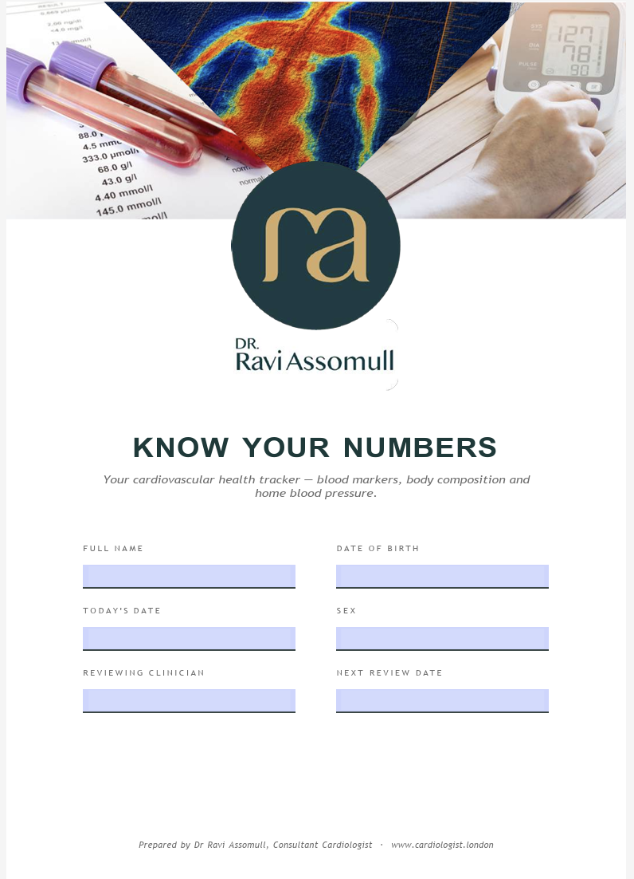
TAKE-HOME MESSAGES
https://www.cardiologist.london/know-your-numbers/
1
Know your numbers
Check BP at home
Aim lower
LDL, non-HDL, and your personal target https://www.cardiologist.london/know-your-numbers/
Treat weight as a condition
Sleep 7+ hours, regularly
Move every day
Eat clean, whole foods
Notes:
Let me leave you with eight things to do after tonight.
One: know your numbers, especially your LDL and non-HDL cholesterol, and ask what your personal target is.
Two: get your Lp(a) tested once in your life, and consider ApoB if you have diabetes, high triglycerides or metabolic syndrome.
Three: check your blood pressure at home with a validated upper-arm monitor, using the NICE protocol.
Four: aim lower. Every 10 millimetres of mercury matters. Cut salt and eat more plants.
Five: treat weight as the medical condition it is. The GLP-1 medicines are a genuine advance when used carefully and for the long term, alongside lifestyle.
Six: give yourself at least seven hours of sleep, at regular times, and get loud snoring checked.
Seven: move every day. Aim for at least 8,000 steps, 150 minutes of activity a week, and resistance training at least twice a week.
And eight: eat clean, whole foods, with protein and fibre at every meal and very little ultra-processed food, and keep alcohol to 10 units a week or less.
None of these is complicated. The challenge is doing them consistently, and that's where good support makes the difference.

Slide 21
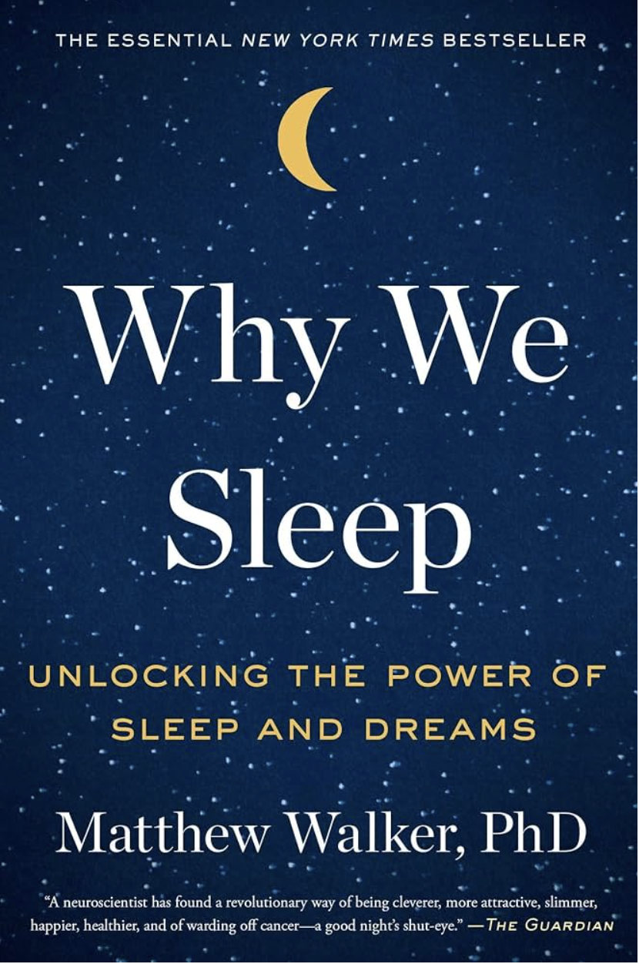
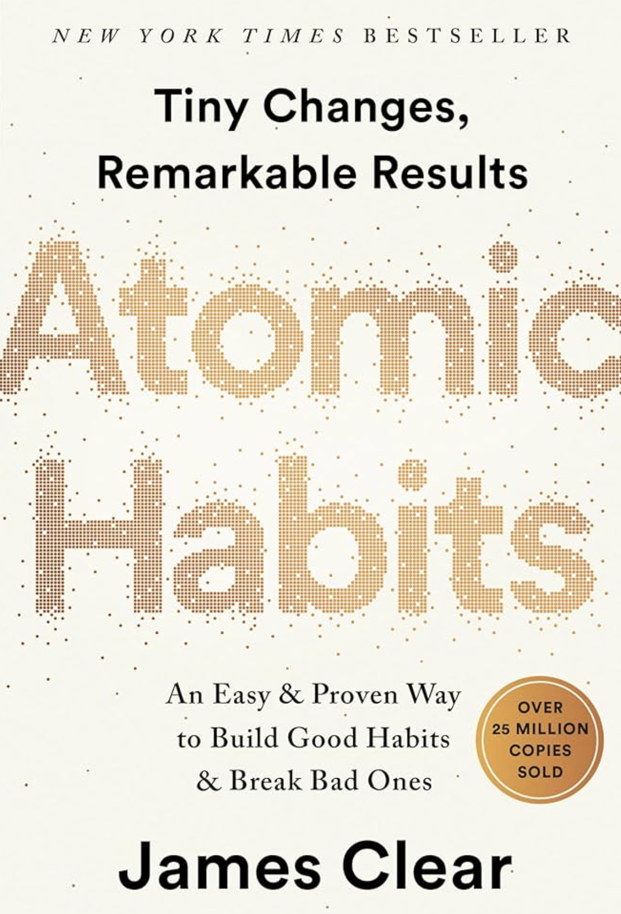
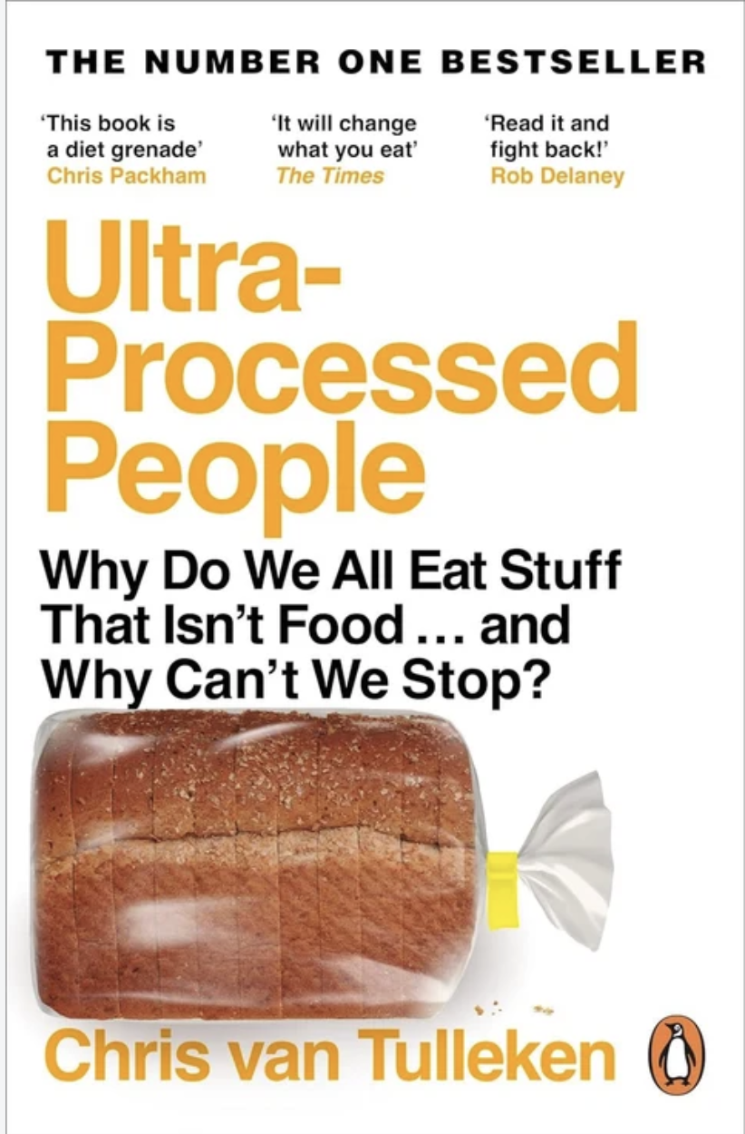
KNOWLEDGE
"The man who does not read has no advantage over the man who cannot read.” Mark Twain
Protect lean mass
Roughly a quarter to two-fifths of the weight lost can be lean (non-fat) mass. Lean mass is not the same as muscle.
Resistance training at least twice a week, adequate protein and good sleep are sensible, low-risk ways to protect strength.
This advice is pragmatic; no trial has yet tested it specifically alongside these drugs.
Notes:
Two practical things I discuss with every patient considering these drugs.
First, what happens when you stop. In the STEP-1 extension, a year after stopping semaglutide, people had regained about two-thirds of the weight they'd lost. That was a small exploratory study, and lifestyle support stopped at the same time. In SURMOUNT-4, people who had lost about 21% on tirzepatide were randomised to continue or switch to placebo. Those on placebo regained 14% of their body weight, while those who continued lost a further 5.5%. So I encourage people to think of these as long-term treatments for a chronic condition, much like blood pressure tablets, rather than a short course.
Second, muscle. When anyone loses weight, some of what's lost is lean tissue rather than fat. With these drugs, estimates range from about a quarter to around two-fifths of the weight lost. In the tirzepatide body-composition study it was about 25% lean mass, a similar proportion to placebo. Lean mass isn't exactly the same as muscle, and we haven't shown that function is harmed. But it makes complete sense to protect strength with resistance training, enough protein and good sleep. I'll be honest that this is pragmatic advice; there isn't yet a trial of resistance training specifically alongside these medicines.

Slide 22
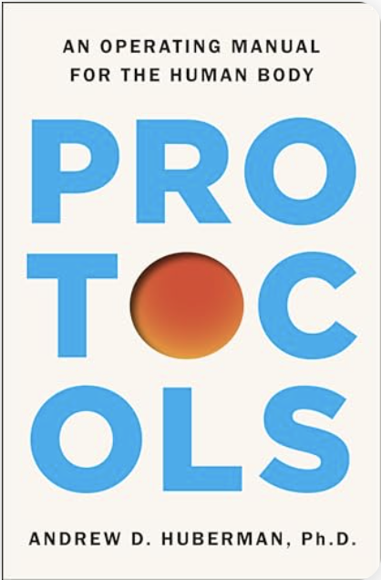
KNOWLEDGE
What I’m reading now and what I will read next
Protect lean mass
Roughly a quarter to two-fifths of the weight lost can be lean (non-fat) mass. Lean mass is not the same as muscle.
Resistance training at least twice a week, adequate protein and good sleep are sensible, low-risk ways to protect strength.
This advice is pragmatic; no trial has yet tested it specifically alongside these drugs.
Notes:
Two practical things I discuss with every patient considering these drugs.
First, what happens when you stop. In the STEP-1 extension, a year after stopping semaglutide, people had regained about two-thirds of the weight they'd lost. That was a small exploratory study, and lifestyle support stopped at the same time. In SURMOUNT-4, people who had lost about 21% on tirzepatide were randomised to continue or switch to placebo. Those on placebo regained 14% of their body weight, while those who continued lost a further 5.5%. So I encourage people to think of these as long-term treatments for a chronic condition, much like blood pressure tablets, rather than a short course.
Second, muscle. When anyone loses weight, some of what's lost is lean tissue rather than fat. With these drugs, estimates range from about a quarter to around two-fifths of the weight lost. In the tirzepatide body-composition study it was about 25% lean mass, a similar proportion to placebo. Lean mass isn't exactly the same as muscle, and we haven't shown that function is harmed. But it makes complete sense to protect strength with resistance training, enough protein and good sleep. I'll be honest that this is pragmatic advice; there isn't yet a trial of resistance training specifically alongside these medicines.

Slide 23
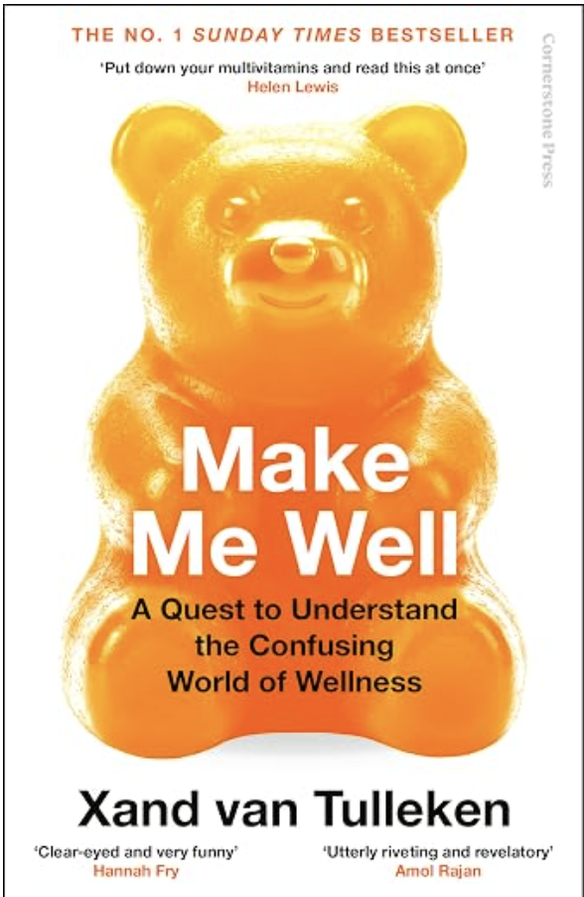
KNOWLEDGE
What I’m reading now and what I will read next
Protect lean mass
Roughly a quarter to two-fifths of the weight lost can be lean (non-fat) mass. Lean mass is not the same as muscle.
Resistance training at least twice a week, adequate protein and good sleep are sensible, low-risk ways to protect strength.
This advice is pragmatic; no trial has yet tested it specifically alongside these drugs.
Notes:
Two practical things I discuss with every patient considering these drugs.
First, what happens when you stop. In the STEP-1 extension, a year after stopping semaglutide, people had regained about two-thirds of the weight they'd lost. That was a small exploratory study, and lifestyle support stopped at the same time. In SURMOUNT-4, people who had lost about 21% on tirzepatide were randomised to continue or switch to placebo. Those on placebo regained 14% of their body weight, while those who continued lost a further 5.5%. So I encourage people to think of these as long-term treatments for a chronic condition, much like blood pressure tablets, rather than a short course.
Second, muscle. When anyone loses weight, some of what's lost is lean tissue rather than fat. With these drugs, estimates range from about a quarter to around two-fifths of the weight lost. In the tirzepatide body-composition study it was about 25% lean mass, a similar proportion to placebo. Lean mass isn't exactly the same as muscle, and we haven't shown that function is harmed. But it makes complete sense to protect strength with resistance training, enough protein and good sleep. I'll be honest that this is pragmatic advice; there isn't yet a trial of resistance training specifically alongside these medicines.

Slide 24




Thank you
Questions welcome
68 Harley Street, London W1G 7HE
cardiologist.london
020 3576 2885
enquiries@cardiologist.london
This talk is general education, not personal medical advice. Please speak to your own doctor about your individual risks and treatment.
Notes:
Thank you very much for your attention. I'm very happy to take questions.
If you'd like to go further, my clinic is at 68 Harley Street, and you'll find articles, guides and short videos on these topics at cardiologist.london.
One final reminder: everything tonight is general education. The right numbers and treatments for you depend on your own history and risk, so please discuss them with your own doctor.

Slide 25
REFERENCES
Key sources (1 of 2)
Mach F et al. 2019 ESC/EAS Guidelines for the management of dyslipidaemias. Eur Heart J 2020;41:111–88. 2025 ESC/EAS Focused Update. Eur Heart J 2025;46:4359–78.
Ference BA et al. LDL causes atherosclerotic cardiovascular disease. EAS consensus. Eur Heart J 2017;38:2459–72.
Cholesterol Treatment Trialists’ Collaboration. Lancet 2010;376:1670–81.
Nordestgaard BG et al. Fasting is not routinely required for a lipid profile. Eur Heart J 2016;37:1944–58.
NICE NG238: Cardiovascular disease: risk assessment and reduction, including lipid modification (2023). NICE CG71: Familial hypercholesterolaemia.
Sniderman AD et al. Apolipoprotein B particles and cardiovascular disease. JAMA Cardiol 2019;4:1287–95.
Kronenberg F et al. Lipoprotein(a) in atherosclerotic cardiovascular disease and aortic stenosis: EAS consensus. Eur Heart J 2022;43:3925–46.
Cegla J et al. HEART UK consensus statement on lipoprotein(a). Atherosclerosis 2019;291:62–70.
2026 ACC/AHA Guideline on the management of dyslipidemia. Circulation 2026.
McEvoy JW et al. 2024 ESC Guidelines for the management of elevated blood pressure and hypertension. Eur Heart J 2024;45:3912–4018.
NICE NG136: Hypertension in adults (2019, updated 2023). 2025 AHA/ACC High Blood Pressure Guideline.
Lewington S et al. Lancet 2002;360:1903–13. Ettehad D et al. Lancet 2016;387:957–67. SPRINT Research Group. NEJM 2015;373:2103–16.
Edwards JJ et al. BJSM 2023;57:1317–26. He FJ et al. BMJ 2013;346:f1325. Sacks FM et al. NEJM 2001;344:3–10. Neal B et al. NEJM 2021;385:1067–77.
Williams B et al. PATHWAY-2. Lancet 2015;386:2059–68. Flack JM et al. BaxHTN. NEJM 2025;393:1363.
WHO fact sheets: Hypertension (2025); Obesity and overweight (2025). Health Survey for England 2024 (NHS England, 2026).
Notes:
Reference list for the talk. Full citations with PubMed identifiers are held in the accompanying evidence notes.

Slide 26
REFERENCES
Key sources (2 of 2)
Wilding JPH et al. STEP-1. NEJM 2021;384:989–1002. Jastreboff AM et al. SURMOUNT-1. NEJM 2022;387:205–16. Aronne LJ et al. SURMOUNT-5. NEJM 2025.
Lincoff AM et al. SELECT. NEJM 2023;389:2221–32. Kosiborod MN et al. STEP-HFpEF. NEJM 2023. Packer M et al. SUMMIT. NEJM 2025. Perkovic V et al. FLOW. NEJM 2024.
Aronne LJ et al. SURMOUNT-4. JAMA 2024;331:38–48. Wilding JPH et al. STEP-1 extension. Diabetes Obes Metab 2022;24:1553–64.
MHRA Drug Safety Updates (June 2025; Jan 2026). EMA PRAC (June 2025, NAION). NICE TA875, TA1026. Wegovy and Mounjaro UK SmPCs.
Hall KD et al. Cell Metab 2019;30:67–77. Tasali E et al. JAMA Intern Med 2022;182:365–74.
Walker M. Why We Sleep. Allen Lane, 2017. Guzey A. guzey.com/books/why-we-sleep (2019).
Watson NF et al. Sleep 2015;38:843–4. Cappuccio FP et al. Eur Heart J 2011;32:1484–92. Windred DP et al. Sleep 2024;47:zsad253.
Sandhu A et al. Open Heart 2014;1:e000019. McEvoy RD et al. SAVE. NEJM 2016;375:919–31. Riemann D et al. J Sleep Res 2023;32:e14035.
Visseren FLJ et al. 2021 ESC Guidelines on CVD prevention. Eur Heart J 2021;42:3227–337. Pelliccia A et al. 2020 ESC Sports Cardiology Guidelines. Eur Heart J 2021;42:17–96.
Bull FC et al. WHO 2020 guidelines. BJSM 2020;54:1451–62. Arem H et al. JAMA Intern Med 2015;175:959–67. Momma H et al. BJSM 2022;56:755–63.
Estruch R et al. PREDIMED. NEJM 2018;378:e34. Delgado-Lista J et al. CORDIOPREV. Lancet 2022;399:1876–85. Jenkins DJA et al. JAMA 2003;290:502–10.
Gardner CD et al. DIETFITS. JAMA 2018;319:667–79. Ge L et al. BMJ 2020;369:m696. Reynolds A et al. Lancet 2019;393:434–45.
Banach M et al. Eur J Prev Cardiol 2023;30:1975–85. Inoue K et al. JAMA Netw Open 2023;6:e235174. Levine JA et al. Science 1999;283:212–4; Science 2005;307:584–6.
Wood AM et al. Lancet 2018;391:1513–23. Voskoboinik A et al. NEJM 2020;382:20–8. UK CMO Low Risk Drinking Guidelines (2016).
EFSA Scientific Opinion on caffeine (2015). Poole R et al. BMJ 2017;359:j5024. Marcus GM et al. CRAVE. NEJM 2023;388:1092–100. Wong CX et al. DECAF. JAMA 2026.
Exercise template (Exercise Protocol 2) and “clean omnivore” nutrition advice adapted from Huberman AD. Protocols: An Operating Manual for the Human Body (2026).
Notes:
Reference list for the talk. Full citations with PubMed identifiers are held in the accompanying evidence notes.

